Slide 1
Boosting Methods and XGBoost
Yu Shi
ADAPT Lab at CS Department
Shanghai Jiao Tong University

Slide 2
Contents
Part I Boosting Methods
Overview
Trees
Gradient Tree Boosting
Part II XGBoost
Second Order Approximation
Split Finding
System Design
Use XGBoost
Evaluation and Conclusion

Slide 3
Part 1
Boosting methods

Slide 4


An overview of boosting methods
Motivation
Some learners are powerful, like neural networks.
Others are relatively weak, like linear regression and trees.
Combines the outputs of many “weak” learners to produce a powerful committee.
Ways to combine “weak” learners
Simply Averaging
A stepwise approach (Basic idea of Boosting)
Training: Train learners f₁,f₂,…,f_{n} independently
Training: Train f_{k+1} given f₁,f₂,…,f_{k}
Testing: Predict $\hat{y}=w_{1}f_{1}\left(x\right)+…+w_{n}f_{n}(x)$
Testing: Predict $\hat{y}=w_{1}f_{1}\left(x\right)+…+w_{n}f_{n}(x)$

Slide 5
















Trees, The Base learners
Why Trees?
Weak, simple learners. Efficient to combine. Easy to tune.
Can handle data sets with both continuous, discrete and even binary features.
How does tree works?
Suppose we have a training data set $\left(x_{1}^{\left(1\right)},x_{2}^{\left(1\right)},y^{\left(1\right)}\right), …,\left(x_{1}^{\left(n\right)},x_{2}^{\left(n\right)},y^{\left(n\right)}\right)$
$$10$$
$$10$$
$$10$$
$$3$$
$$x_{1}$$
$$x_{1}$$
$$x_{1}$$
Class A
$$4$$
$$4$$
Class B
$$4$$
$$0$$
$$10$$
$$0$$
$$7$$
$$10$$
$$0$$
$$7$$
$$10$$
$$x_{2}$$
$$x_{2}$$
$$x_{2}$$

Slide 6







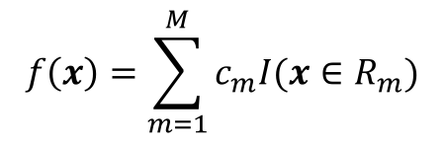








Trees, The Base learners
$$10$$
$$3$$
$$x_{1}≤4$$
$$R_{3}$$
$$R_{4}$$
Class A
$$x_{2}≤7$$
$$x_{2}≤3$$
$$x_{1}$$
Class B
$$4$$
$$R_{1}$$
$$R_{2}$$
$$R_{1}$$
$$R_{2}$$
$$R_{3}$$
$$R_{4}$$
$$x_{2}$$
$$7$$
Formally, what’s a tree?
$$f\left(x\right)=\sum_{m=1}^{M}{c_{m}I(x∈R_{m})}$$
Hypothesis Function:
Parameters:
$$R_{i},c_{i},i=1,2,…,M$$
Loss Function: Choose as you like. (e.g. L2 loss for regression)

Slide 7

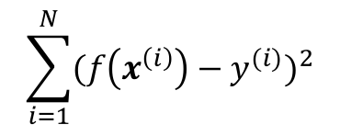
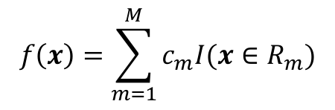




Trees, The Base learners
Training a tree
Assuming that we’re solving a regression problem with square loss.
Choose Parameters
$$R_{m},c_{m},m=1,2,…,M$$
to minimize
$$\sum_{i=1}^{N}{{(f\left(x^{\left(i\right)}\right)−y^{(i)})}^{2}}$$
$$f\left(x\right)=\sum_{m=1}^{M}{c_{m}I(x∈R_{m})}$$
where
Once
are decided, calculating optimal
is simple
$R_{m}$’s
$c_{m}$’s
$$\hat{c_{m}}=avg(y_{i}|x_{i}∈R_{m})$$
Splitting space into
$R_{m}$’s
is the main problem
Be greedy! Starting from the root, split the leaves such that the loss is maximally reduced. Let’s call this process tree growing.

Slide 8












Trees, The Base learners
$$x_{1}≤4$$
$$x_{2}≤7$$
$$x_{2}≤3$$
Tree growing
At first, we have only a root.
Each step, split either by
$$x_{1}$$
or
$$x_{2}$$
$$10$$
$$3$$
Step1 Split root at
$$x_{1}=4$$
Step2 Split left child at
$$x_{1}$$
$$x_{2}=7$$
$$4$$
Step3 Split right child at
$$x_{2}=3$$
$$x_{2}$$
$$7$$
Suppose${ x}_{1}$ has $k$ different values on a node and ${ x}_{2}$ has $l$ different values,
how many choices we have when splitting the node?
$$k+l$$

Slide 9
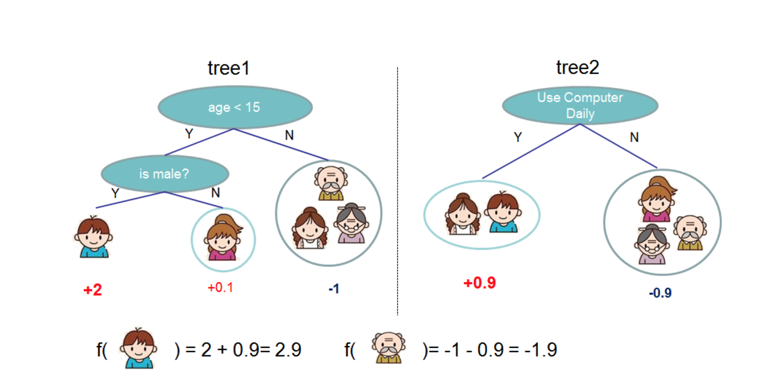
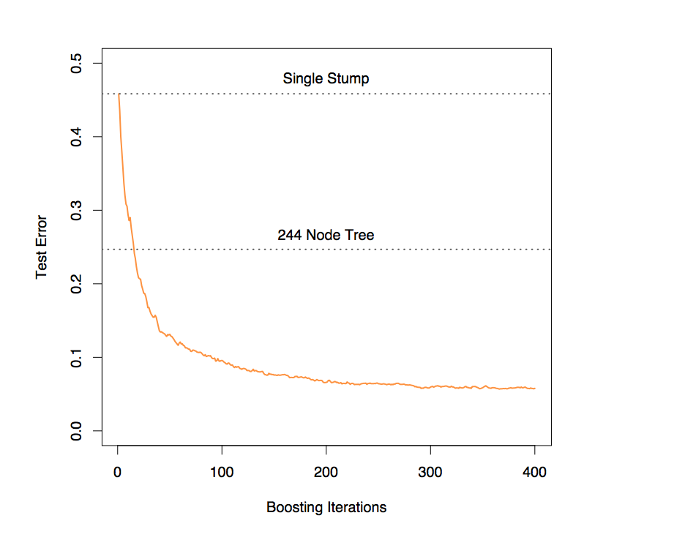
Gradient Tree Boosting
One tree is weak, want to ensemble results of many trees

Slide 10
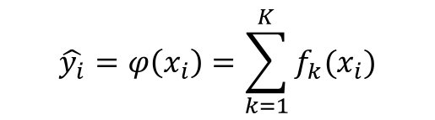
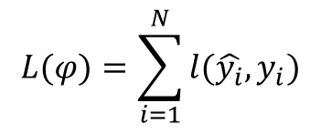
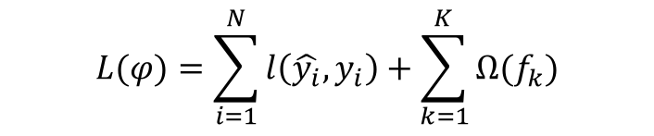
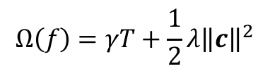

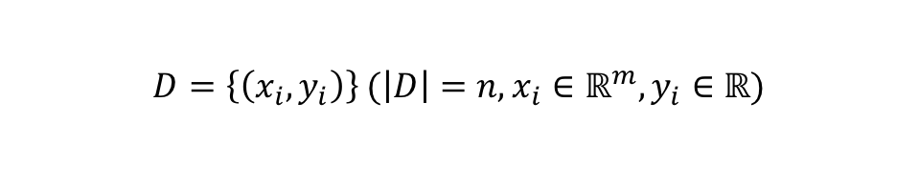
Gradient Tree Boosting
Setting
Training data set with m features and n examples
$$D=\left\{\left(x_{i},y_{i}\right)\right\} (\left|D\right|=n,x_{i}∈ℝ^{m},y_{i}∈ℝ)$$
Try to fit the data with K trees
$$\hat{y_{i}}=φ\left(x_{i}\right)=\sum_{k=1}^{K}{f_{k}(x_{i})}$$
Loss function
$$L(φ)=\sum_{i=1}^{N}{l(\hat{y_{i}},y_{i})}$$
Add Regularization Terms
$$L(φ)=\sum_{i=1}^{N}{l\left(\hat{y_{i}},y_{i}\right)+\sum_{k=1}^{K}{Ω(f_{k})}}$$
$$Ω\left(f\right)=γT+\frac{1}{2}λ{\left\|c\right\|}^{2}$$
Number of leaves of tree $f$
Square sum of leaf value

Slide 11
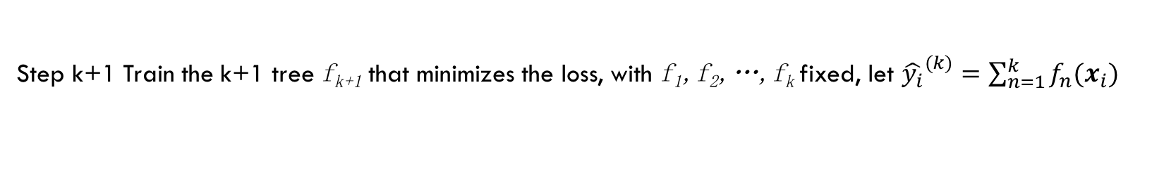
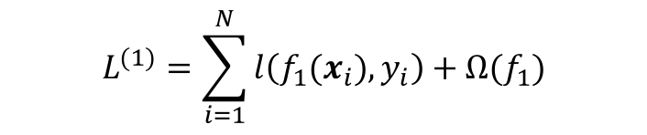
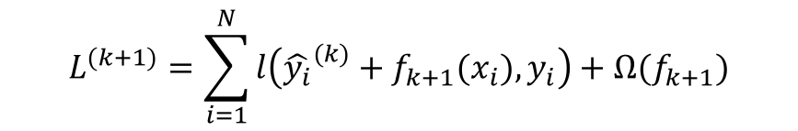

Gradient Tree Boosting
Recap
Basic idea of Boosting
Training: Train tree f_{k+1} given trees f₁,f₂,…,f_{k}
Testing: Predict $\hat{y}=f_{1}\left(x\right)+…+f_{n}(x)$
Gradient Tree Boosting Algorithm
Step1 Train the first tree f₁ that minimizes the loss
$$L^{(1)}=\sum_{i=1}^{N}{l\left(f_{1}(x_{i}),y_{i}\right)+Ω(f_{1})}$$
Step k+1 Train the k+1 tree f_{k+1} that minimizes the loss, with f₁,f₂,…,f_{k} fixed, let ${\hat{y_{i}}}^{(k)}=\sum_{n=1}^{k}{f_{n}(x_{i})}$
$$L^{(k+1)}=\sum_{i=1}^{N}{l\left({{\hat{y_{i}}}^{(k)}+f}_{k+1}(x_{i}),y_{i}\right)+Ω(f_{k+1})}$$

Slide 12

Gradient Tree Boosting
Intuition Behind the Algorithm
Suppose we use square loss, then at step k+1
$$L^{(k+1)}=\sum_{i=1}^{N}{{\left({{\hat{y_{i}}}^{\left(k\right)}+f}_{k+1}\left(x_{i}\right)−y_{i}\right)}^{2}+Ω\left(f_{k+1}\right)=}\sum_{i=1}^{N}{{\left((y_{i}−{{\hat{y_{i}}}^{\left(k\right)})−f}_{k+1}\left(x_{i}\right)\right)}^{2}+Ω\left(f_{k+1}\right)}$$
We are still training a single tree as in step1, but on data set
$$D_{k}=\left\{\left(x_{i},y_{i}−{\hat{y_{i}}}^{\left(k\right)}\right)\right\}$$
Step k+1 remedy the error of the first k steps

Slide 13
Part 2
XGboost

Slide 14




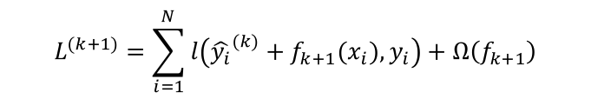
XGBOOST second order Approximation
Second Order Approximation
$$g_{i}=\frac{ⅆl(y,y_{i})}{ⅆy},h_{i}=\frac{ⅆ^{2}l(y,y_{i})}{{ⅆy}^{2}}$$
Let
$$l\left({{\hat{y_{i}}}^{(k)}+f}_{k+1}(x_{i}),y_{i}\right)≈l\left({\hat{y_{i}}}^{\left(k\right)},y_{i}\right)+g_{i}f_{k+1}\left(x_{i}\right)+\frac{1}{2}h_{i}{f_{k+1}\left(x_{i}\right)}^{2}$$
Then
Suppose our k+1 tree has $T$ leaves, $R_{j}$ is the feature space of leaf $j$
Let $I_{j}$ be the set of training data points belonging to $R_{j}$
$$L^{(k+1)}=\sum_{i=1}^{N}{l\left({{\hat{y_{i}}}^{(k)}+f}_{k+1}(x_{i}),y_{i}\right)+Ω\left(f_{k+1}\right)}$$
$$=\sum_{i=1}^{N}{l\left({{\hat{y_{i}}}^{(k)}+f}_{k+1}(x_{i}),y_{i}\right)+}γT+\frac{1}{2}λ{\left\|c\right\|}^{2}$$
$$≈\sum_{i=1}^{N}{g_{i}f_{k+1}\left(x_{i}\right)+\frac{1}{2}h_{i}{f_{k+1}\left(x_{i}\right)}^{2}+}γT+\frac{1}{2}λ{\left\|c\right\|}^{2}+C$$
$$=\sum_{j=1}^{T}{\left[\left(\sum_{i∈I_{j}}{g_{i}}\right)c_{j}+\frac{1}{2}\left(\sum_{i∈I_{j}}{h_{i}}+λ\right){c_{j}}^{2}\right]+γT+C}$$

Slide 15
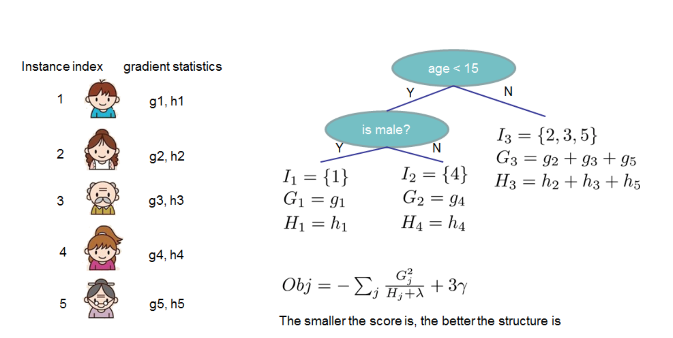



XGBOOST second order Approximation
Optimal Leaf Values
$$L^{(k+1)}≈\sum_{j=1}^{T}{\left[\left(\sum_{i∈I_{j}}{g_{i}}\right)c_{j}+\frac{1}{2}\left(\sum_{i∈I_{j}}{h_{i}}+λ\right){c_{j}}^{2}\right]+γT+C}$$
It is easy to find out the best $w$, with $I_{j}$ fixed
$$c_{j}^{∗}=−\frac{\sum_{i∈I_{j}}{g_{i}}}{\sum_{i∈I_{j}}{h_{i}+λ}}$$
and the corresponding minimum loss
$$L^{∗}=−\frac{1}{2}\sum_{j=1}^{T}{\frac{{\left(\sum_{i∈I_{j}}{g_{i}}\right)}^{2}}{\sum_{i∈I_{j}}{h_{i}+λ}}+γT}+C$$
When split a leaf $I$ into $I_{L}$ and $I_{R}$, the loss reduction
$$L_{split}=\frac{1}{2}\left[\frac{{\left(\sum_{i∈I_{L}}{g_{i}}\right)}^{2}}{\sum_{i∈I_{L}}{h_{i}+λ}}+\frac{{\left(\sum_{i∈I_{R}}{g_{i}}\right)}^{2}}{\sum_{i∈I_{R}}{h_{i}+λ}}−\frac{{\left(\sum_{i∈I}{g_{i}}\right)}^{2}}{\sum_{i∈I}{h_{i}+λ}}\right]−γ$$

Slide 16
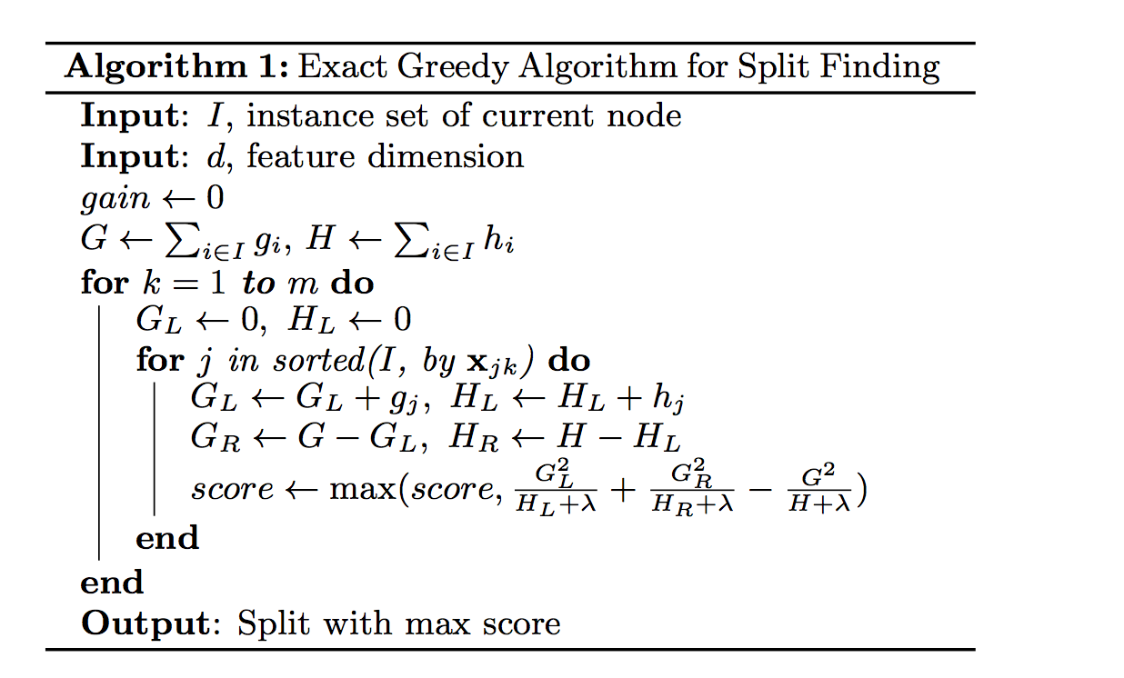
XGBoost Split Finding
G=1.4
H=4.6
Exact Greedy Algorithm
x1 | x2 | g | h
9 | 1 | 0.3 | 1.1
4 | 5 | -1.2 | 2.0
3 | 3 | 0.1 | 0.8
8 | 9 | 2.2 | 0.7
x1 | x2 | g | h
3 | 3 | 0.1 | 0.8
4 | 5 | -1.2 | 2.0
8 | 9 | 2.2 | 0.7
9 | 1 | 0.3 | 1.1
Iterate over all possible split points of every feature
Sort by x1
G_{L}=0.1 H_{L}=0.8
G_{R}=1.3 H_{R}=3.8
G_{L}=-1.1 H_{L}=2.8
G_{R}=2.5 H_{R}=1.8
G_{L}=1.1 H_{L}=3.5
G_{R}=0.3 H_{R}=1.1
G_{L}=1.4 H_{L}=4.6
G_{R}=0 H_{R}=0

Slide 17


XGBoost Split Finding
Approximate Algorithm
When data size is large, can be expensive
Iterate over all possible split points of every feature
Data can’t even be read into memory for sort
For feature $k$, find
$$\left\{s_{k1},…,s_{kl}\right\}⊆\{x_{k1},…,x_{kn}\}$$
as candidate split points

Slide 18
XGBoost Split Finding
Sparsity Aware
Some feature values are often quite sparse
Just consider the non-zero feature values as split point
x1 | x2 | g | h
1 | 0 | 0.3 | 1.1
0 | 1 | -1.2 | 2.0
2 | 0 | 0.1 | 0.8
0 | -1 | 2.2 | 0.7
0 | 0 | 1.3 | 0.1
0 | 0 | 0.9 | 0.3
x1 | x2 | g | h
1 | 0 | 0.3 | 1.1
2 | 0 | 0.1 | 0.8
0 | 1 | -1.2 | 2.0
0 | -1 | 2.2 | 0.7
0 | 0 | 1.3 | 0.1
0 | 0 | 0.9 | 0.3
x1 | x2 | g | h
0 | 0 | 1.3 | 0.1
0 | 1 | -1.2 | 2.0
0 | 0 | 0.9 | 0.3
0 | -1 | 2.2 | 0.7
1 | 0 | 0.3 | 1.1
2 | 0 | 0.1 | 0.8
Split zero value point to right
Sort by x1 (nonzero)
Split zero value point to left

Slide 19
XGBoost System Design
Column Block, split all leaves collectively
i | g | h | Leaf id
0 | 0.3 | 1.1 | 0
1 | -1.2 | 2.0 | 0
2 | 0.1 | 0.8 | 1
3 | 2.2 | 0.7 | 0
4 | 1.3 | 0.1 | 1
5 | 0.9 | 0.3 | 1
i | x1 | x2
0 | 1 | 0
1 | 3 | 1
2 | 2 | 0
3 | 1 | -1
4 | 5 | 0
5 | 1 | 0
i | x1 | x2 | g | h | Leaf id
0 | 1 | 0 | 0.3 | 1.1 | 0
1 | 3 | 1 | -1.2 | 2.0 | 0
2 | 2 | 0 | 0.1 | 0.8 | 1
3 | 1 | -1 | 2.2 | 0.7 | 0
4 | 5 | 0 | 1.3 | 0.1 | 1
5 | 1 | 0 | 0.9 | 0.3 | 1
Leaf 0
Leaf 1
x1 | x2
(1,0) | (-1,3)
(1,3) | (1,1)
(1,5)
(2,2)
(3,1)
(5,4)
G_{0L}=0 G_{0R}=1.3
G_{1L}=0 G_{1R}=2.3
H_{0L}=0 H_{0R}=3.8
H_{1L}=0 H_{1R}=1.2
G_{0L}=0.3 G_{0R}=1.0
G_{1L}=0 G_{1R}=2.3
H_{0L}=1.1 H_{0R}=2.7
H_{1L}=0 H_{1R}=1.2
G_{0L}=2.5 G_{0R}=-1.2
G_{1L}=0 G_{1R}=2.4
H_{0L}=1.8 H_{0R}=2.0
H_{1L}=0 H_{1R}=1.2
Information Table for Each Data Point
G_{0L}=2.5 G_{0R}=-1.2
G_{1L}=0.9 G_{1R}=1.5
H_{0L}=1.8 H_{0R}=2.0
H_{1L}=0.3 H_{1R}=0.9

Slide 20
XGBoost System Design
Parallelism
Thread1
Thread2
Leaf 0
Leaf 1
x1 | x2
(1,0) | (1,1)
(1,3) | (-1,3)
(1,5)
(2,2)
(3,1)
(5,4)
Thread1: Best Split Point for Leaf 0: x1=a
Best Split Point for Leaf 0: x1=a
Thread2: Best Split Point for Leaf 0: x2=b

Slide 21
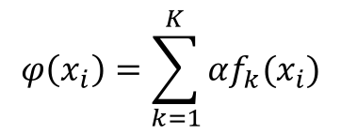
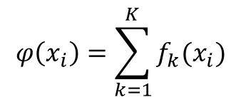
Use xgboost
Shrinkage
$$φ\left(x_{i}\right)=\sum_{k=1}^{K}{f_{k}(x_{i})}$$
$$φ\left(x_{i}\right)=\sum_{k=1}^{K}{αf_{k}(x_{i})}$$
Subsampling
Use only part of the training data when growing a tree
Column Sampling
By tree: Use only subset of the features when growing a whole tree
By level: Use only subset of the features when growing a tree to next level
User defined objective function
As long as its second order gradient exists
Python, R and JVM packages

Slide 22
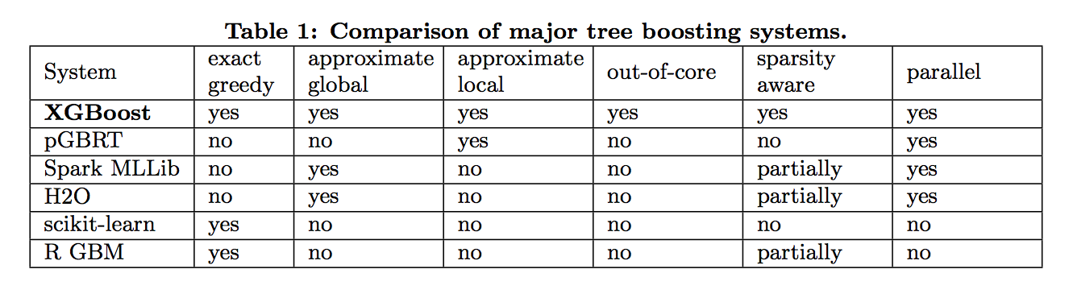
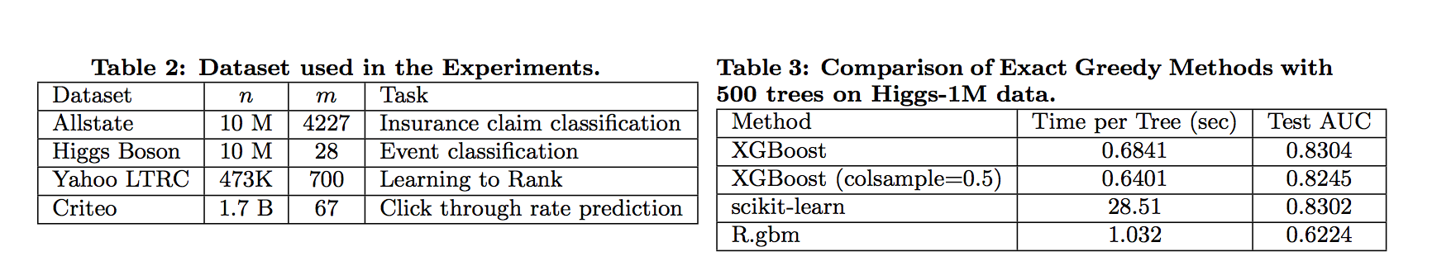
Evaluation and conclusion
Comparison
Speed and Accuracy

Slide 23
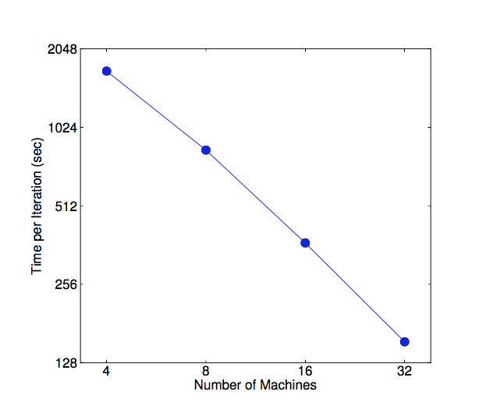
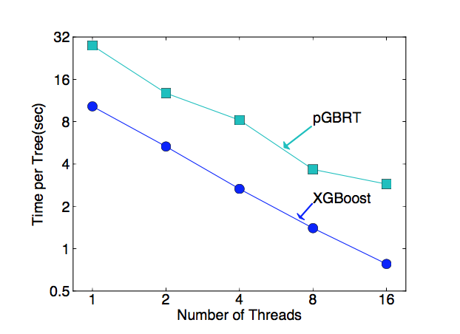
Evaluation and conclusion
Scale out
Yahoo LTRC dataset
Criteo dataset

Slide 24

Evaluation and conclusion
A Tree Based Boosting System
Second Order Approximation
Column Block Data Structure for Parallelism
Shrinkage, Subsampling to Prevent Overfitting

